Slide 1
Dr. Yifeng Zhu Electrical and Computer Engineering University of Maine
Embedded Systems with ARM Cortex-M Microcontrollers in Assembly Language and C
Chapter 12
Fixed-point and Floating-point Arithmetic
Spring 2020

Slide 2
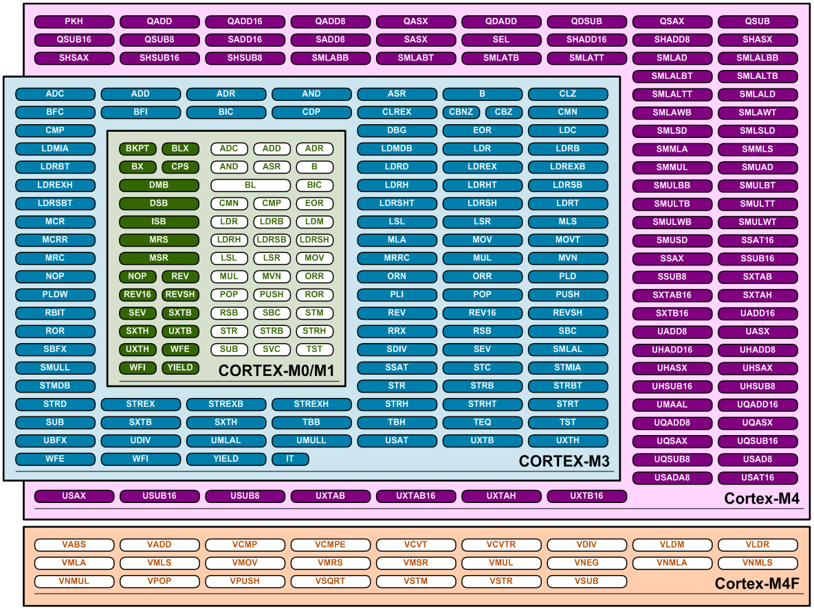
ARM Cortex-M Instruction Sets
Basic data processing
I/O control tasks
Advanced data processing
Bit field manipulations
Digital Signal Processing
Floating Point
from arm.com

Slide 3
FPU on Cortex-M4
Cortex-M4 = Cortex-M3 + DSP + FPU (optional)
FPU is optional
from arm.com

Slide 4
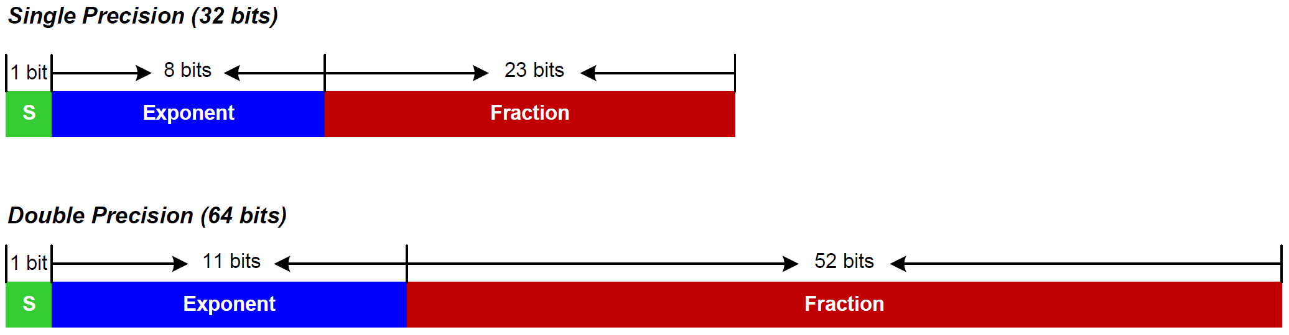
FPU on Cortex-M4
“float” in C
“double” in C
Cortex-M4
FPU only support single precision.
FPU

Slide 5
Floating-point Multiplication
float area_of_rectangle(float length, float width) { float area; area = length * width; return area; }
r0
s0
r1
s1
r0
s0
Software-based FP Multiplication
; Inputs: ; r0 = length ; r1 = width ; Return: ; r0 = area area_of_rectangle PROC PUSH {lr} ; call software library BL __aeabi_fmul POP {pc} ; return area in r0 ENDP
Hardware-based FP Multiplication
; Inputs: ; s0 = length ; s1 = width ; Return: ; s0 = area area_of_rectangle PROC ; Call FPU instructions VMUL.F32 s0, s0, s1 BX lr ; return area in s0 ENDP

Slide 6
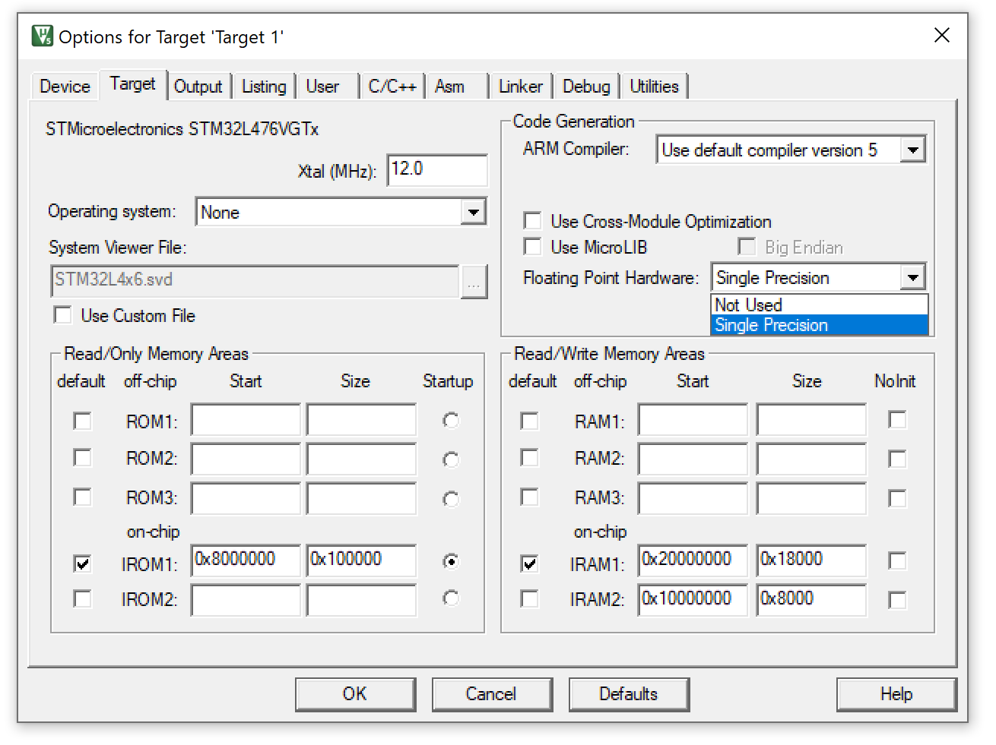
ARM Keil
Not Used
FP operations are performed by software FP library
Single Precision
Single-precision performed by FPU hardware directly
Double-precision performed by software FP library

Slide 7
Enable FPU
CPACR
Coprocessor Access Control Register (CPACR) in System Control Block (SCB)
SCB->CPACR |= (0xF<<20);
from arm.com

Slide 8
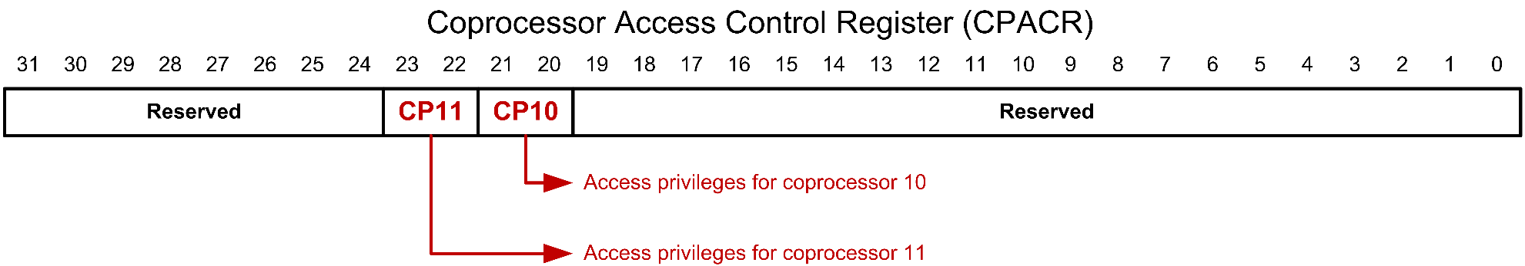
Enable FPU
00 = Access denied (default). Any attempted access generates a NOCP (no co-processor) fault.
01 = Privileged access only. An unprivileged access generates a NOCP fault.
10 = Reserved.
11 = Full access.
C Program | Assembly Program
// Enable FPU by setting CP10 and // CP11 fields in System Control // Block (SCB) SCB->CPACR |= (0xF << 20); | ; Load SCB base address (0xE000ED00) LDR r0, = SCB_BASE ; Read SCB->CPACR LDR r1, [r0, #SCB_CPACR] ; Enable full access to CP10 and CP11 ORR r1, r1, #(0xF << 20) ; Write SCB->CPACR STR r1, [r0, #SCB_CPACR];

Slide 9
Floating-point Unit (FPU)
Cortex-M Registers
FPU coprocessor
FPU Registers
r0
ARM Cortex-M
Registers r0–r15
Floating-point Unit
Registers s0–s31
s1
s0
r1
s3
s2
r2
s5
s4
r3
s7
s6
r4
s9
s8
r5
s11
s10
r6
s13
s12
r7
LDR
POP
STR
PUSH
VLDR
VPOP
VSTR
VPUSH
s15
s14
r8
s17
s16
r9
s19
s18
r10
s21
s20
r11
Memory
s23
s22
r12
s25
s24
r13(SP)
s27
s26
r14(LR)
s29
s28
r15(PC)
s31
s30
xPSR
FPCAR
PRIMASK
FPSCR
FAULTMASK
FPCCR
BASEPRI
CONTROL
Notes:
The FPU has 32 single-precision general registers.
Floating-Point Context Address Register (FPCAR)
Floating-Point Context Control Register (FPCCR)
Floating-Point Status Control Register (FPSCR)

Slide 10
Floating-Point Registers
64 bits
FPU Registers
d0
s1
s0
d0
s1
s0
d1
s3
s2
d2
s5
s4
d3
s7
s6
upper
32 bits
lower
32 bits
d4
s9
s8
d5
s11
s10
d6
s13
s12
d7
s15
s14
Load a float from address in r0
d8
s17
s16
VLDR.F32 s0, [r0]
d9
s19
s18
d10
s21
s20
d11
s23
s22
Load a double from address in r0
d12
s25
s24
d13
s27
s26
; stored into s1 and s0
VLDR.F64 d0, [r0]
d14
s29
s28
d15
s31
s30
s = single precision (32 bits)
d = double precision (64 bits)
Stack operations
VPUSH.64 {d0,d1}
VPUSH.32 {r4,r6}

Slide 11
FPU Instructions
 | ARM Cortex-M | FPU
Accessing memory | LDR, STR, LDM, STM, PUSH, POP | VLDR, VSTR, VLDM, VSTM, VPUSH, VPOP
Copying registers | MOV, MRS, MSR | VMOV, VMRS, VMSR
Arithmetic | ADD, SUB, MULS, SDIV/UDIV, | VADD, VSUB, VMUL, VDIV
Multiply-Accumulation | MLA, MLS | VMLA, VMLS
Comparison | CMP | VCMP
Advanced Arithmetic |  | VABS, VNEG, VSQRT
VMLA Sd, Sn, Sm ; Sd = Sd + Sn * Sm
VMLS Sd, Sn, Sm ; Sd = Sd - Sn * Sm

Slide 12
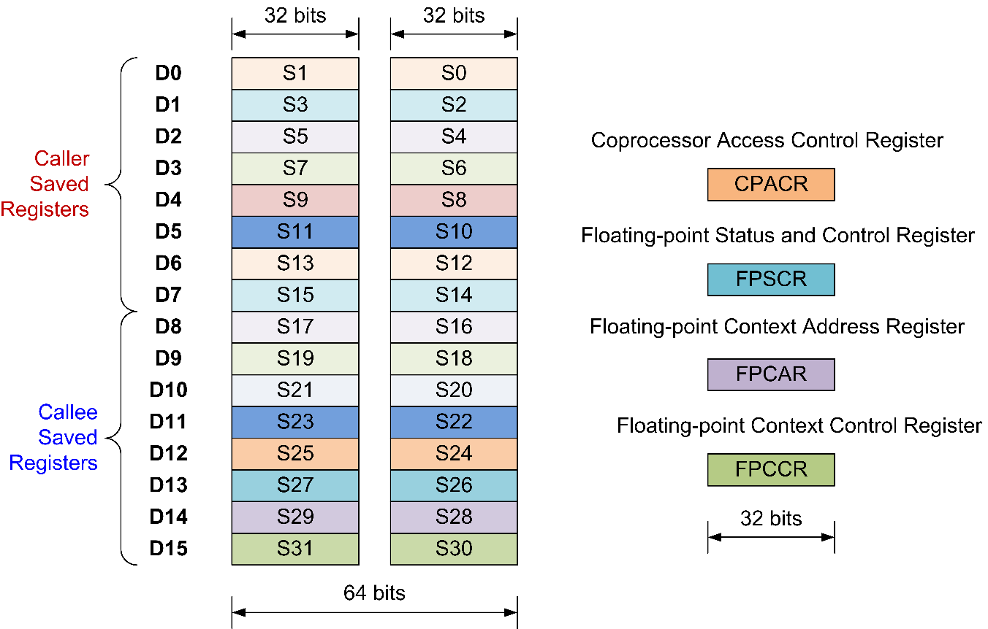
Register Usages across Function Calls

Slide 13
Register Usages across Function Calls
A PROC
...
VPUSH {s3, s5}
BL B ; call function B
VPOP {s3, s5}
...
ENDP
B PROC
...
ENDP

Slide 14
Register Usages across Function Calls
A PROC
...
VPUSH {s3, s5}
BL B ; call function B
VPOP {s3, s5}
...
ENDP
B PROC
VPUSH {s17}
VLDR.F32 s17, [r0]
...
VPOP {s17}
ENDP

Slide 15
Passing Arguments to a Procedure
Each argument is assigned in turn to the next free register of the corresponding type
Example:
double fun(double a1, float a2, double a3, float a4, float a5, double a6, float a7, double a8)
FPU Registers
d0
a1
s1
s0
d1
s3
a2
a4
s2
d2
a3
s5
s4
d3
a7
a5
s7
s6
d4
a6
s9
s8
d5
a8
s11
s10
d6
s13
s12
d7
s15
s14
d8
s17
s16
d9
s19
s18
d10
s21
s20
d11
s23
s22
d12
s25
s24
d13
s27
s26
d14
s29
s28
d15
s31
s30

Slide 16
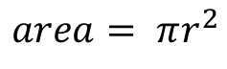
Example 1: Area of Circle
$$area= πr^{2}$$
float area(float radius){
float pi = 3.14;
float area;
area = pi * radius * radius;
return area;
}
r
Implementation in assembly
area PROC
EXPORT area
VLDR.F32 s1, =3.1416 ; Pseudo-instruction
VMUL.F32 s1, s1, s0 ; r0 = radius (input argument)
VMUL.F32 s0, s1, s0 ; return area in s0
BX LR
ENDP

Slide 17
Transfer data between FPU and ARM
ARM Cortex-M
Registers r0–r15, APSR
VMOV
Floating-point Unit
Registers s0–s31
Example:
VMOV r0, s0 ; Copy s0 into r0
VMOV s1, r1 ; Copy r1 into s0
ARM Cortex-M
Registers r0–r15, APSR
VMRS
Floating-point Unit
Special Registers
FPSCR, FPCAR, FPCCR
VMSR
VMRS: Move into ARM register from FPU special register
VMSR: Move into FPU special register from ARM register
Example: Change the rounding mode to round toward zero
VMRS r0, FPSCR ; Read current FPSCR
ORR r0, r0, #(3<<22) ; Set bits 22 and 23 to 1
VMSR FPSCR, r0 ; Save into FPSCR
Notes:
Rounds to the nearest value. This is the default configuration.

Slide 18
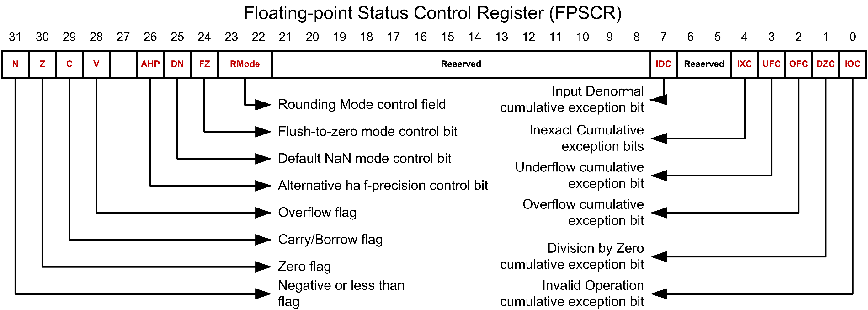
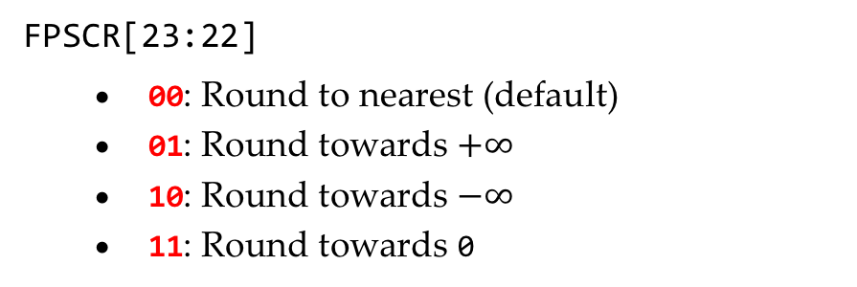
Floating-point Status Control Register (FPSCR)
FPSCR[23:22]
00: Round to nearest (default)
01: Round towards $+∞$
10: Round towards $−∞$
11: Round towards 0

Slide 19
Example 2: Comparison
Copy N, Z, C, V flags from FPU status register to ARM core APSR
ARM Cortex-M
APSR
VMRS
Floating-point Unit
FPSCR
VMRS APSR_nzcv, FPSCR
float max(float a, float b){
if (a > b)
return a;
else
return b;
}
max PROC
; Update NZCV in FPSCR
VCMP.F32 s0, s1
; Copy NZCV flags to APSR
VMRS APSR_nzcv, FPSCR
VMOVLE.F32 s0, s1
ENDP

Slide 20
Convert Integer to Floating Point
signed integer
unsigned integer
VCVT.F32.S32
VCVT.F64.U32
VCVT.F32.U32
VCVT.F64.S32
single precision
double precision
Example:
VCVT.F64.U32 d2, s0 ; Convert unsigned integer to double

Slide 21
Convert Floating Point to Integer
signed integer
unsigned integer
VCVT.S32.F32
VCVT.U32.F64
VCVT.U32.F32
VCVT.S32.F64
single precision
double precision
Example:
VCVT.U32.F64 s0, d2 ; Convert double to unsigned integer

Slide 22
Convert between Fixed-Point and Single Precision
N: the number of fraction bits in fixed point
Td: type and size of fixed point
S32: signed 32-bit value
U32: unsigned 32-bit value
S16: signed 16-bit value
U16: unsigned 16-bit value
VCVT.Td.F32 Sd, Sm, #n
VCVT.Td.F32 Sd, Sd, #n
VCVT.F32.Td Sd, Sm, #n
VCVT.F32.Td Sd, Sd, #n
Example:
VCVT.F32.S32 s0, s0, #10 ; Convert a 32-bit fixed point to float
; Fraction part of the fixed point has 10 bits

Slide 23
Automatic Stacking & Unstacking
Interrupt
Exit
Interrupt Handler
Interrupt
Request
Unstacking
User Program
User Program
Stacking
Time

Slide 24
Automatic Stacking & Unstacking
Old SP
xxxxxxxx
xPSP
PC (r15)
LR (r14)
r12
r3
r2
r1
r0
Old SP
xxxxxxxx
FPSCR
s15
s14
s13
...
...
s0
xPSP
PC (r15)
LR (r14)
r12
r3
r2
r1
r0
Auto
Stacking
17 FPU registers
Auto
Stacking
FPCAR
New SP
Without FPU
New SP
With FPU

Slide 26

Passing Arguments
Each number is assigned in turn to the next free register of the corresponding type
Example:
double fun(double a1, float a2, double a3, float a4,
float a5, double a6, float a7, double a8)
a1
a2
a4
a3
a7
a6
a6
a8

Slide 27
Precision Conversion
VCVT{R}.S32.F32 Sd, Sm | Convert from single-precision float to signed 32-bit (S32) or unsigned 32-bit (U32) integer.
VCVT{R}.U32.F32 Sd, Sm
VCVT{R}.F32.S32 Sd, Sm | Convert to single-precision float from signed 32-bit (S32) or unsigned 32-bit (U32) integer.
VCVT{R}.F32.U32 Sd, Sm
VCVT{R}.Td.F32 Sd, Sm, #n | Convert between single-precision and fixed-point. Td can be S16 (signed 16-bit), U16 (unsigned 16-bit), S32 (signed 32-bit), and U32 (unsigned 32-bit). #n is the number of fraction bits in the fixed-point number.
VCVT{R}.Td.F32 Sd, Sd, #n
VCVT{R}.F32.Td Sd, Sm, #n
VCVT{R}.F32.Td Sd, Sd, #n
VCVT<B|T>.F32.F16 Sd, Sm | Converts half-precision float to single-precision (B = bottom half of Sm, T = top half of Sm)
VCVT<B|T>.F16.F32 Sd, Sm | Converts single-precision float to half-precision (B = bottom half of Sd, T = top half of Sd)
{R}: R is optional, and it means conversion with Rounding

Slide 28
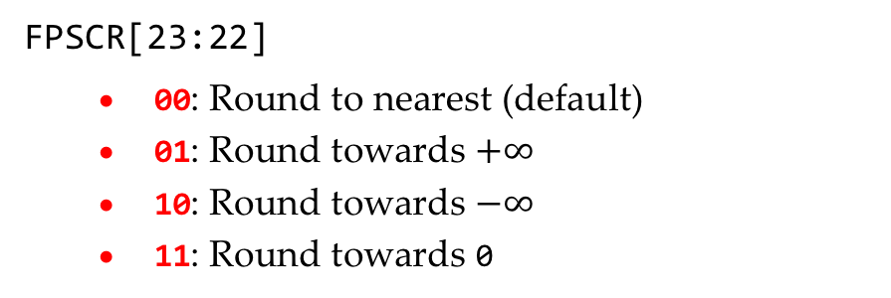
Floating-point Status Control Register (FPSCR)
FPSCR[23:22]
00: Round to nearest (default)
01: Round towards $+∞$
10: Round towards $−∞$
11: Round towards 0

Slide 29
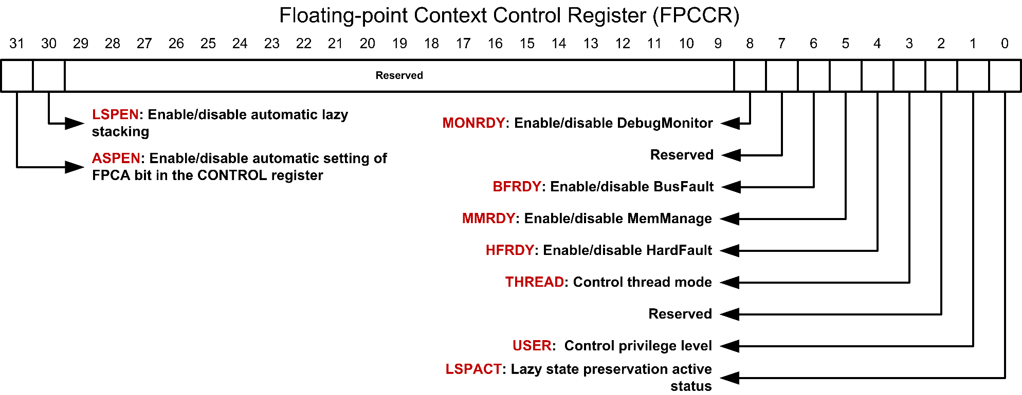
Floating-point Context Control Register (FPCCR)
Three FPU context save/restore configurations:
Lazy save/store (default): LSPEN = 1, ASPEN = x
No FPU register saving: LSPEN = 0, ASPEN = 0
Automatic save/restore: LSPEN = 0, ASPEN = 1

Slide 30
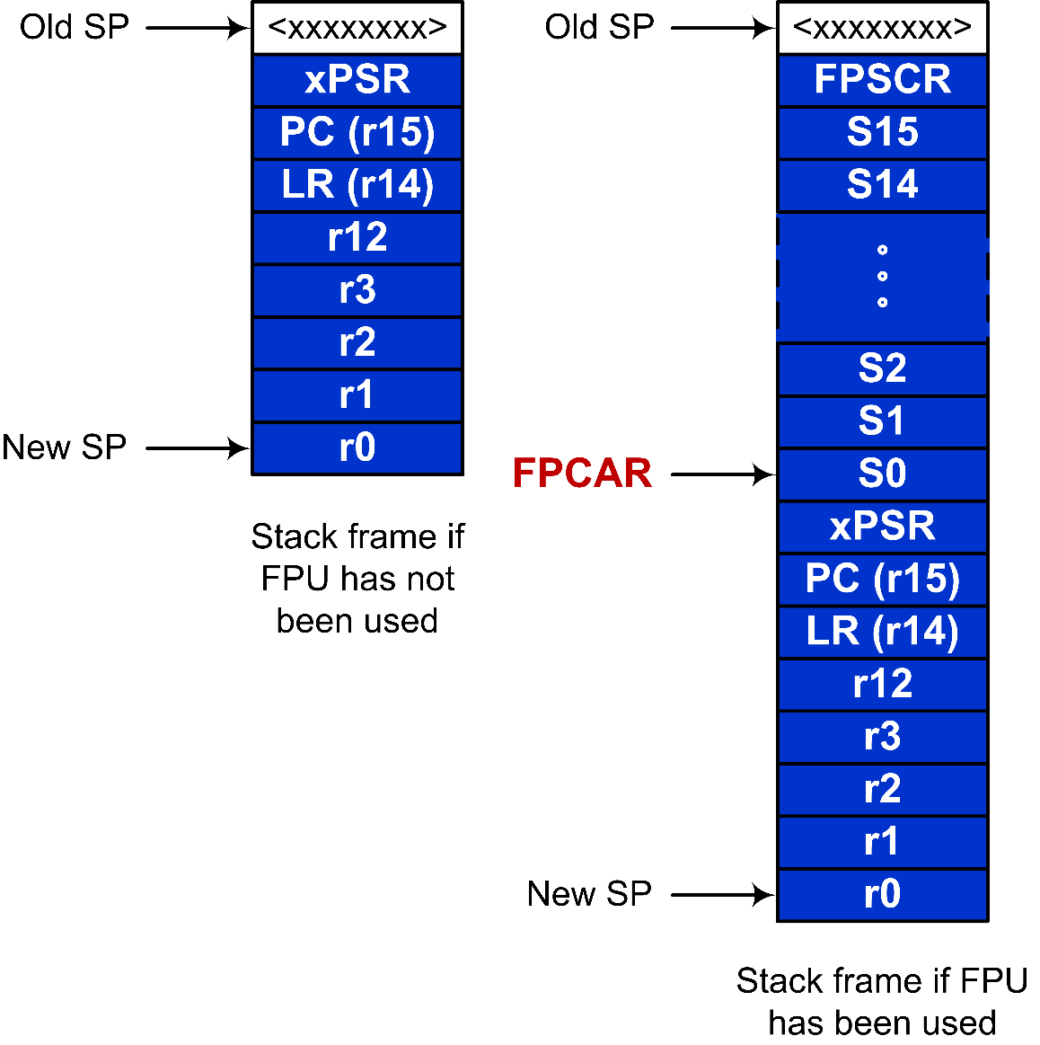
Automatic Stacking and Unstacking upon Interrupt

Slide 31
Load and Store Floating-point Numbers
VLDR.F32 Sd, [Rn] | Load one single-precision float
VLDR.F64 Dd, [Rn] | Load one double-precision float
VSTR.32 Sd, [Rn] | Store one float registers
VSTR.64 Dd, [Rn] | Store one double register
VLDM.32 Rn{!}, list | Load multiple single-precision floats
VLDM.64 Rn{!}, list | Load multiple double-precision floats
VSTM.32 Rn{!}, list | Store multiple float registers
VSTM.64 Rn{!}, list | Store multiple double registers
VPOP.32 list | Pop float registers from stack
VPOP.64 list | Pop double registers from stack
VPUSH.32 list | Push float registers to stack
VPUSH.64 list | Push double registers to stack
Examples:
VLDR.F32 s0, [r0, #4] ; Pre-index, s0 = mem[r0 + 4]
VLDR.F32 s0, [r0], #4 ; Post-index, s0 = mem[r0], r0 += 4
VLDR.F32 s0, [r0, #4]! ; Pre-index with update, s0 = mem[r0 + 4], r0 += 4
VLDM.64 r0, {d0-d7} ; Load 8 double precision numbers
VSDM.64 r0, {d0-d7} ; Store 8 double precision numbers
VPUSH.32 {s16-s31} ; Save floating point registers
VPOP.32 {s16-s31} ; Restore floating point registers

Slide 32
Copy Floating-point Numbers
VMOV.F32 Sd, #imm | Move immediate to float-register
VMOV.F32 Sd, Sm | Copy from single-precision register to single-precision register
VMOV.F64 Dd, Dm | Copy from double-precision register to double-precision register
VMOV Sn, Rt | Copy ARM core register to float register
VMOV Sm1, Sm2, Rt1, Rt2 | Copy 2 ARM core registers to 2 float registers
VMOV Dd[x], Rt | Copy ARM core register to a half of a double-precision floating-point register, where x is 0 or 1.
VMOV Rt, Dn[x] | Copy a half of a double-precision floating-point register to ARM core register, where x is 0 or 1.
Examples:
VMOV s0, s1, r0, r1 ; s0 = r0, s1 = r1
VMOV r1, d0 [1] ; r1 = d0 [1] = s1
VMOV.F32 s1, #3.25 ; s1 = 3.25

Slide 33
Single-precision Arithmetic Operations
VADD.F32 {Sd,} Sn, Sm | Add floating points, Sd = Sn + Sm
VSUB.F32 {Sd,} Sn, Sm | Subtract float, Sd = Sn - Sm
VDIV.F32 {Sd,} Sn, Sm | Divide single-precision floats, Sd = Sn/Sm
VMUL.F32 {Sd,} Sn, Sm | Multiply float, Sd = Sn * Sm
VNMUL.F32 {Sd,} Sn, Sm | Negate and multiply float, Sd = -1 * Sn * Sm
VNEG.F32 Sd, Sm | Negate float, Sd = -1 * Sm
VABS.F32 Sd, Sm | Absolute value of floats, Sd = |Sm|
VSQRT.F32 Sd, Sm | Square-root of float
C Function | Assembly Function
float area_of_circle(float radius){ float PI = 3.14; float area; area = PI * radius * radius; return area; } | area_of_circle PROC EXPORT area_of_circle VLDR.F32 s1,=3.14 ; Pseudo-instruction VMUL.F32 s1,s1,s0 ; r0 = radius VMUL.F32 s0,s1,s0 ; return area in s0 ENDP

Slide 34
Single-precision Arithmetic Operations
VLMA.F32 {Sd,} Sn, Sm | Multiply float, then accumulate float, Sd = Sd + Sn*Sm
VLMS.F32 {Sd,} Sn, Sm | Multiply float, then subtract float, Sd = Sd - Sn*Sm
VNMLA.F32 Sd, Sn, Sm | Multiply float, then accumulate, then negate float, Sd = -1 * (Sd + Sn * Sm)
VNMLS.F32 Sd, Sn, Sm | Multiply float, then subtract, then negate float, Sd = -1 * (Sd - Sn * Sm)
Fused MAC instructions: intermediate result are not rounded. ⟹ Better accuracy
VFMA.F32 {Sd,} Sn, Sm | Multiply (fused) then accumulate float, Sd = Sd + Sn*Sm
VFMS.F32 {Sd,} Sn, Sm | Multiply (fused) then subtract float, Sd = Sd - Sn*Sm
VFNMA.F32 {Sd,} Sn, Sm | Multiply (fused) then accumulate then negate float, Sd = -1 * Sd + Sn * Sm
VFNMS.F32 {Sd,} Sn, Sm | Multiply (fused) then subtract then negate float, Sd = -1 * Sd - Sn * Sm

Slide 35
Single-precision Arithmetic Operations
VADD.F32 {Sd,} Sn, Sm | Add floating points, Sd = Sn + Sm
VSUB.F32 {Sd,} Sn, Sm | Subtract float, Sd = Sn - Sm
VDIV.F32 {Sd,} Sn, Sm | Divide single-precision floats, Sd = Sn/Sm
VMUL.F32 {Sd,} Sn, Sm | Multiply float, Sd = Sn * Sm
VNMUL.F32 {Sd,} Sn, Sm | Negate and multiply float, Sd = -1 * Sn * Sm
VNEG.F32 Sd, Sm | Negate float, Sd = -1 * Sm
VABS.F32 Sd, Sm | Absolute value of floats, Sd = |Sm|
VSQRT.F32 Sd, Sm | Square-root of float
C Function | Assembly Function
float area_of_circle(float radius){ float PI = 3.14; float area; area = PI * radius * radius; return area; } | area_of_circle PROC EXPORT area_of_circle VLDR.F32 s1,=3.14 ; Pseudo-instruction VMUL.F32 s1,s1,s0 ; r0 = radius VMUL.F32 s0,s1,s0 ; return area in s0 ENDP

Slide 36
Single-precision comparisons
VCMP.F32 Sd, <Sm | #0.0> | Compare two floating-point registers, or one floating-point register and zero
VCMPE.F32 Sd, <Sm | #0.0> | Compare two floating-point registers, or one floating-point register and zero, and raise exception for a signaling NaN
C Program | Assembly Program
float max(float a, float b){ if (a > b) return a; else return b; } | max PROC VCMPE.F32 s0, s1 ; Copy NZCV flags to APSR VMRS APSR_nzcv, FPSCR BGT exit VMOV.F32 s0, s1 exit BX LR ENDP

Slide 37
Single-precision comparisons
VCMP.F32 Sd, <Sm | #0.0> | Compare two floating-point registers, or one floating-point register and zero
VCMPE.F32 Sd, <Sm | #0.0> | Compare two floating-point registers, or one floating-point register and zero, and raise exception for a signaling NaN
C Program | Assembly Program
float max(float a, float b){ if (a > b) return a; else return b; } | max PROC VCMPE.F32 s0, s1 ; Copy NZCV flags to APSR VMRS APSR_nzcv, FPSCR BGT exit VMOV.F32 s0, s1 exit BX LR ENDP

Slide 38
Precision Conversion
VCVT{R}.S32.F32 Sd, Sm | Convert from single-precision float to signed 32-bit (S32) or unsigned 32-bit (U32) integer.
VCVT{R}.U32.F32 Sd, Sm
VCVT{R}.F32.S32 Sd, Sm | Convert to single-precision float from signed 32-bit (S32) or unsigned 32-bit (U32) integer.
VCVT{R}.F32.U32 Sd, Sm
VCVT{R}.Td.F32 Sd, Sm, #n | Convert between single-precision and fixed-point. Td can be S16 (signed 16-bit), U16 (unsigned 16-bit), S32 (signed 32-bit), and U32 (unsigned 32-bit). #n is the number of fraction bits in the fixed-point number.
VCVT{R}.Td.F32 Sd, Sd, #n
VCVT{R}.F32.Td Sd, Sm, #n
VCVT{R}.F32.Td Sd, Sd, #n
VCVT<B|T>.F32.F16 Sd, Sm | Converts half-precision float to single-precision (B = bottom half of Sm, T = top half of Sm)
VCVT<B|T>.F16.F32 Sd, Sm | Converts single-precision float to half-precision (B = bottom half of Sd, T = top half of Sd)

Slide 39
Passing Arguments
Each number is assigned in turn to the next free register of the corresponding type
Example:
double fun(double a1, float a2, double a3, float a4, float a5, double a6, float a7, double a8)

Slide 40
Example: Square Root
C Code | Assembly Code
float my_sqrt(float x){ float root, root_old = 1.0; do { root = root_old; root_old = (root + x / root) / 2; } while(root_old != root); return root; } | __asm float my_sqrt_assembly(float x){ VMOV.F32 s2,s0 ; s0 = x VMOV.F32 s3,#1 ; s3 = root_old VMOV.F32 s1,s3 loop VMOV.F32 s0, s1 ; root = root_old; VDIV.F32 s3,s2,s0 VADD.F32 s3,s3,s0 VMOV.F32 s4,#2 VDIV.F32 s5,s3,s4 VMOV.F32 s1,s5 VCMP.F32 s1,s0 VMRS APSR_nzcv,FPSCR BNE loop BX lr }

